Slide 1
Final Project:
Waterfalls
Elizabeth Trunk
CMP-262-26599

Slide 2
Introduction
Goal: To learn more about New Jersey waterfalls
Groups that may benefit:
Environmental researchers
Geography nerds
Tourism companies

Slide 3
Methodology
Dataset found on NJGIN Open Data (.csv file)
https://njogis-newjersey.opendata.arcgis.com/datasets/njdep::natural-waterfalls-in-new-jersey/about
Each record of the dataset is about a single waterfall
Every waterfall in NJ that meets the min. requirements is included, with some exceptions
Worked with characteristics such as height, classification, and location
Jupyter Notebooks was used to complete the project

Slide 4
Results

Slide 5
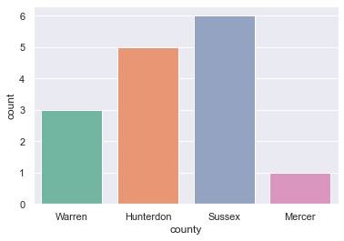
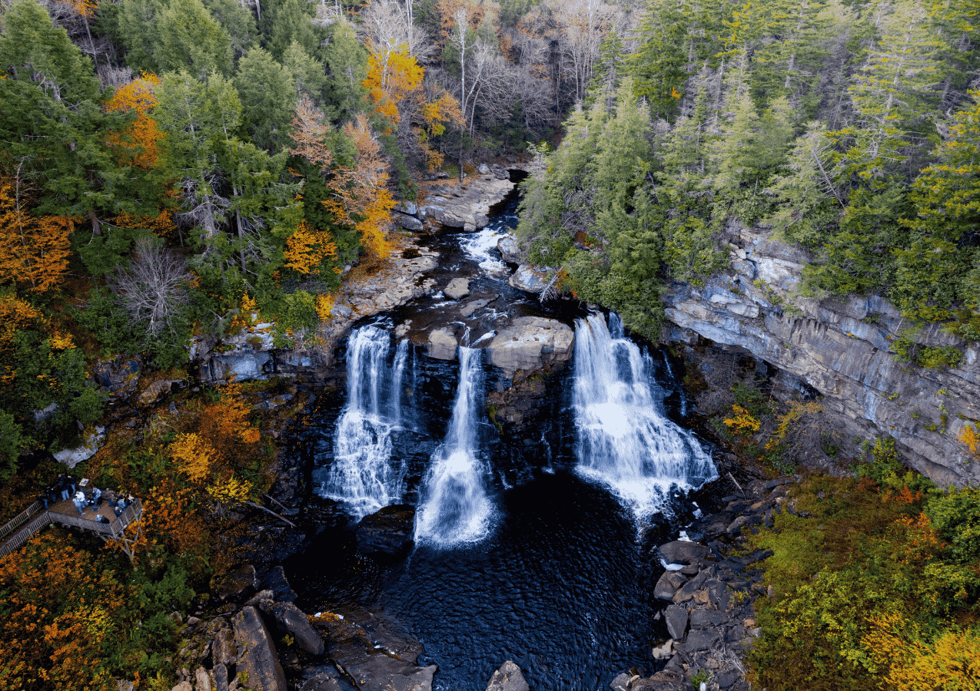
Q1: What is the distribution by county of waterfalls that are sourced from the Delaware River?
Most waterfalls in New Jersey that are sourced from the Delaware River are in Sussex County.

Slide 6
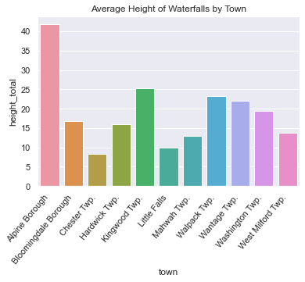
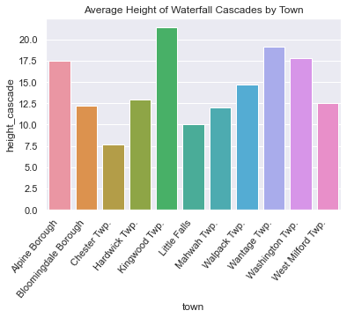
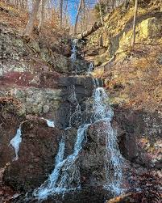
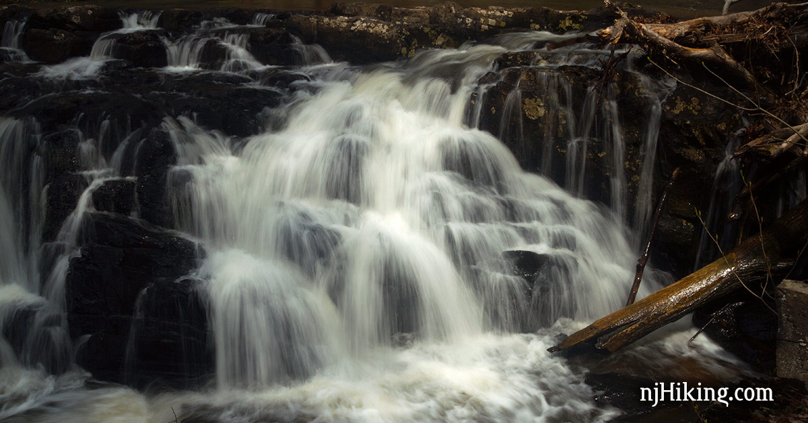
Q2: Out of the municipalities with more than 3 waterfalls, which ones have the biggest on average?
Alpine has the largest waterfalls on average, and Kingwood has the largest cascades. The graphs demonstrate that although a waterfall might be tall, that doesn’t mean the cascades are as tall.
Greenbrook Falls (top) and Lockatong High Falls (right)

Slide 7
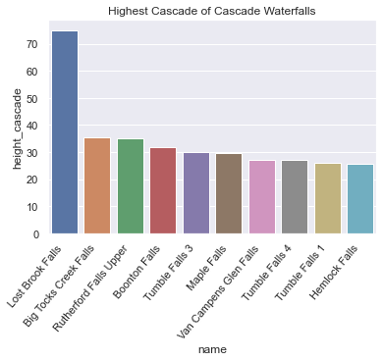
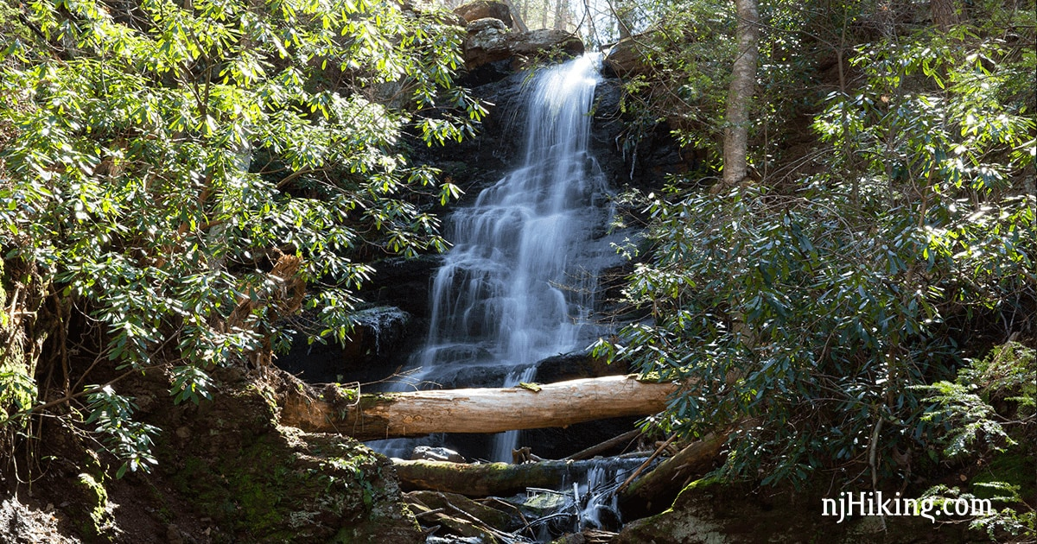
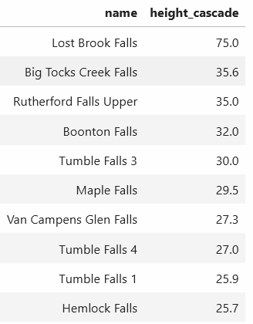
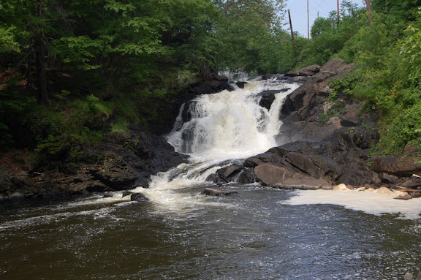
Q3: What were the waterfalls with the top 10 cascade heights that are cascade-type waterfalls?
Lost Brook Falls in Tenafly has a significantly higher cascade than the rest.
Buttermilk Falls (top) and Boonton Falls (bottom)

Slide 8
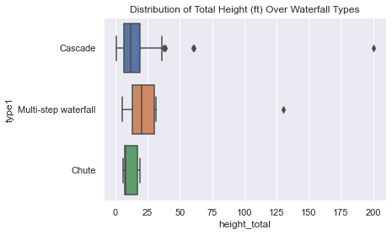
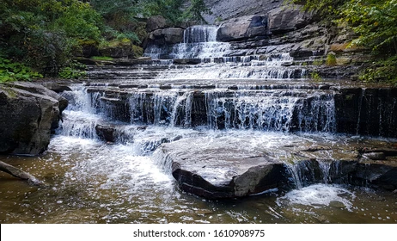
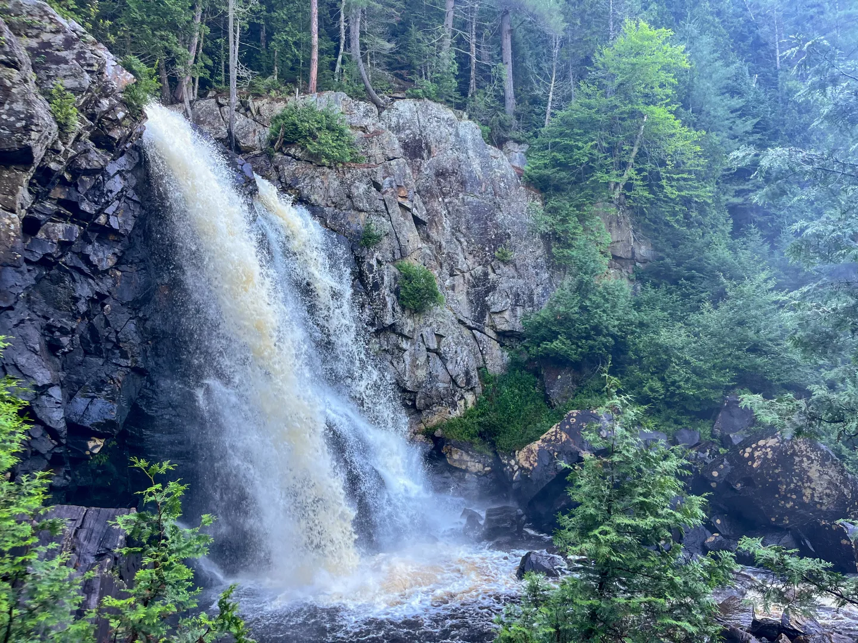
Q4: Is there a correlation between waterfall type and total height?
There is not much of a dramatic difference between heights, but with the data given we can say there may be a slight correlation. We would have to collect more data to say for sure.
Multi-step
Chute

Slide 9
Future Work
In the future, I would like to take more time to explore my dataset to generate more meaningful questions.
Ex. Asking questions based on previous knowledge, or questions that may affect me
Since this dataset is small, I feel like I could’ve had more interesting results with more data. I wasn’t able to get a conclusive answer to question 4.

Slide 10
Thank you!

